Slide 1
A hyphen is used to used to join two words to clarify meaning and avoid any confusion in a sentence. For example: ‘man-eating shark’ has a different meaning to ‘man eating shark’.
Ambiguity is when something is unclear.
A prefix is a letter or a group of letters which are added to the front of a word to change its meaning. For example: 're-' added to 'do' makes 'redo'.

Slide 2
Let’s start with a question about the prefixes ‘re-’ and ‘over-’, which is linked to the new learning later in this lesson.

Slide 3

Add the prefix ‘re-’ or ‘over-’ to each underlined root word to create a new word that matches each meaning below.
A. to do again
B. to feel lots of joy
C. to paint again
D. to eat too much

Slide 4
Add the prefix ‘re-’ or ‘over-’ to each underlined root word to create a new word that matches each meaning below.
A. to do again redo
B. to feel lots of joy overjoyed
C. to paint again repaint
D. to eat too much overeat

Slide 5
Now that we are ready to move on, we can learn about recognising and using hyphens to avoid ambiguity.

Slide 6
Hyphens can be used to separate prefixes and root words in order to avoid confusion.
Sometimes, when we add a prefix to a word, it can make a new word that has a different meaning. Therefore to keep the meaning, we need to use a hyphen.
remark
re-mark
to make a comment
to mark again

Slide 7


Hyphens can be used to separate prefixes and root words in order to avoid confusion.
Where a prefix ends with a vowel and the root word begins with a vowel, a hyphen is sometimes used to avoid two vowels sitting next to each other.
reentry
re-entry
incorrect
correct

Slide 8
Sort the root words into the table below.
when a prefix is added, it needs a hyphen to retain its meaning | when a prefix is added, it needs a hyphen to avoid a double vowel
turn
cover
operate
call
own
examine

Slide 9
Sort the root words into the table below.
when a prefix is added, it needs a hyphen to retain its meaning | when a prefix is added, it needs a hyphen to avoid a double vowel
re-turn re-cover re-call | co-operate co-own re-examine
turn
cover
operate
call
own
examine
Return, recover and recall without the hyphens all have different meanings.

Slide 10
Phrases may have different meanings with or without a hyphen.
For example:
man eating shark
man-eating shark
a man is eating a shark
a shark that eats people

Slide 11

Sometimes, more than one hyphen is needed to join the parts of the adjective.
One or more of the adjectives would not make sense on their own.
The most common example of this is age.
For example:
The nine-year-old boy loved dinosaurs.

Slide 12
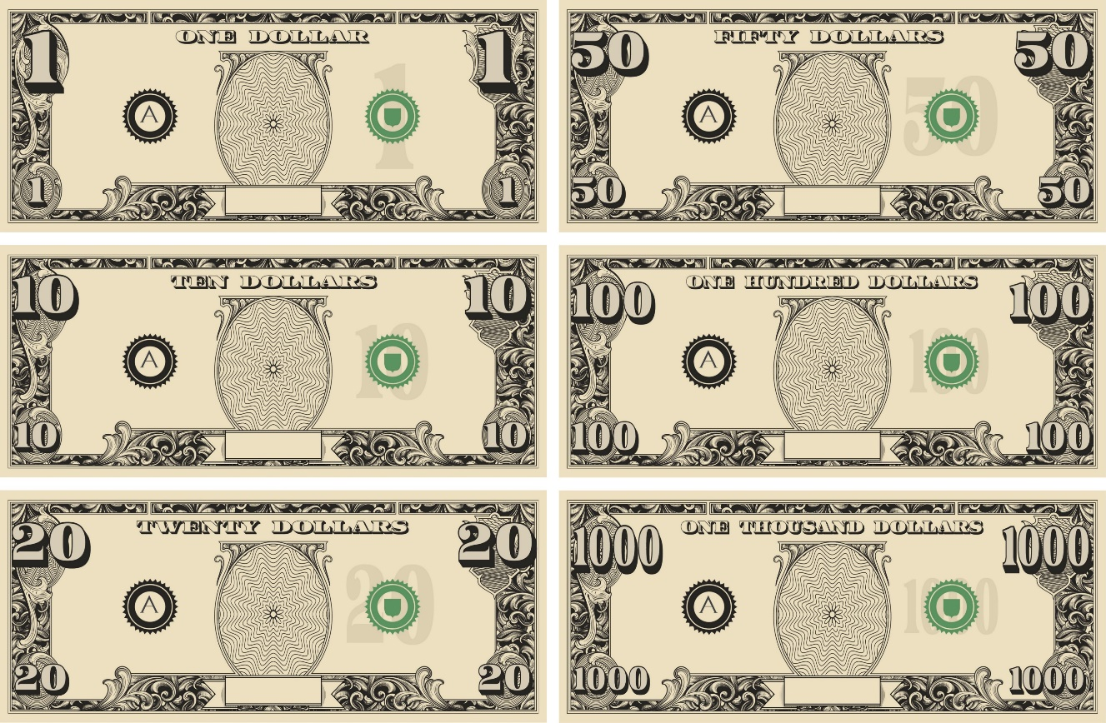
Sentences can also make sense with or without a hyphen, but the meaning changes.
For example:
I want ten dollar notes. In this sentence, ten notes that have a value of one dollar each are wanted.
I want ten-dollar notes. In this sentence, notes with a value of ten dollars each are wanted, but the quantity is not specified.

Slide 13


Sometimes, changing a comma to a hyphen can change the meaning of a sentence.
For example:
I ate red, hot chillies. In this sentence the colour and heat (or spiciness) of the chillies are being described.
I ate red-hot chillies. In this sentence, we are being told that the chillies are really, really hot (or spicy).

Slide 14
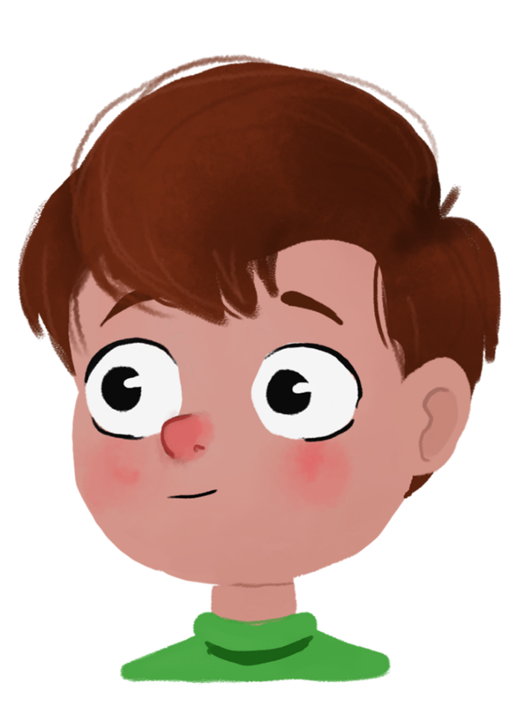
Insert the hyphen(s) in each sentence below.
A. The sugar free sweets were given to every child.
B. The half eaten bagel sat on the worktop.
C. My hair was described as being strawberry blonde by my hairdresser.
D. The five year old girl was waiting patiently for her mum.

Slide 15
Insert the hyphen(s) in each sentence below.
A. The sugar-free sweets were given to every child.
B. The half-eaten bagel sat on the worktop.
C. My hair was described as being strawberry-blonde by my hairdresser.
D. The five-year-old girl was waiting patiently for her mum.
The hyphens are needed to join the adjectives because one or more of the adjectives
do not make sense on their own.

Slide 16

Which sentence tells us that the appointment at the doctors is every six weeks?
A. I have six, weekly appointments at the doctors.
B. I have six-weekly appointments at the doctors.
C. I have six weekly-appointments at the doctors.

Slide 17
Which sentence tells us that the appointment at the doctors is every six weeks?
A. I have six, weekly appointments at the doctors.
B. I have six-weekly appointments at the doctors.
C. I have six weekly-appointments at the doctors.
Sentence B tells us that the appointment is every six weeks.
Sentence A tells us that there is one appointment per week at the doctors for six weeks.
Sentence C is incorrect because ‘weekly-appointments’ is not an adjective
so cannot be joined with a hyphen.

Slide 18
Now that we can recognise and use hyphens to avoid ambiguity, let’s apply our learning to some further application and reasoning questions.

Slide 19
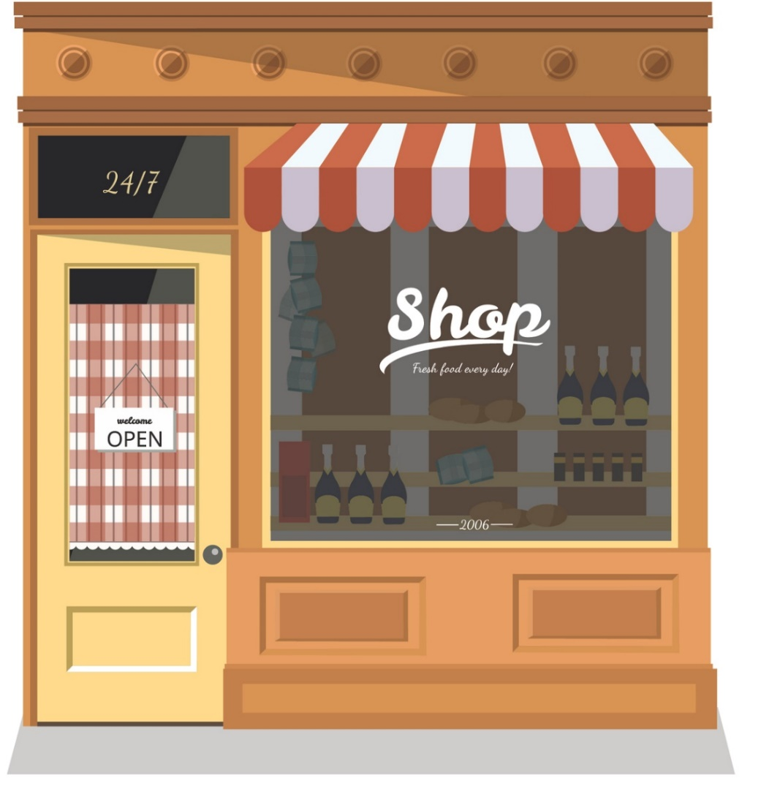
Explain how the sentences below differ in meaning.
A. The small-business advisor was helping the shop owner.
B. The small business advisor was helping the shop owner.

Slide 20
Explain how the sentences below differ in meaning.
A. The small-business advisor was helping the shop owner.
B. The small business advisor was helping the shop owner.
In sentence A, the advisor is for businesses that are small. Whereas in sentence B, the business advisor is being described as small.

Slide 21
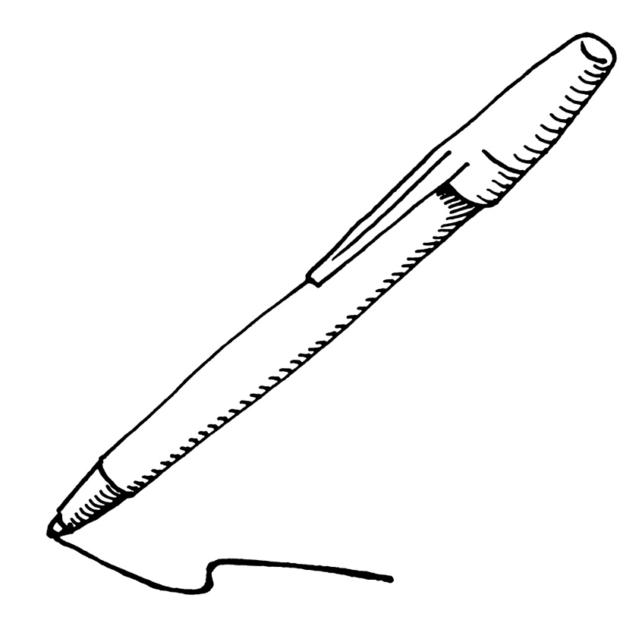
Add a prefix to the root word below.
sign
Write two different sentences, with different meanings. One must use a hyphen.

Slide 22
Add a prefix to the root word below.
sign
Write two different sentences, with different meanings. One must use a hyphen.
Various answers, for example:
I need to re-sign the documents as they got wet.
I need to resign from my job as I am moving to Australia.

Slide 24
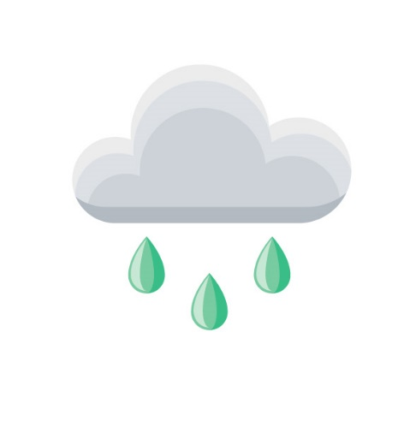
True or false? The sentence below has correctly used a hyphen to avoid ambiguity.
The sudden downpour of rain re-freshed the flowers in the garden.
Varied Fluency 1

Slide 25
True or false? The sentence below has correctly used a hyphen to avoid ambiguity.
The sudden downpour of rain re-freshed the flowers in the garden.
False, refreshed does not need a hyphen because the hyphen does not separate two vowels and is not needed to make the word meaning clear.
Varied Fluency 1

Slide 26
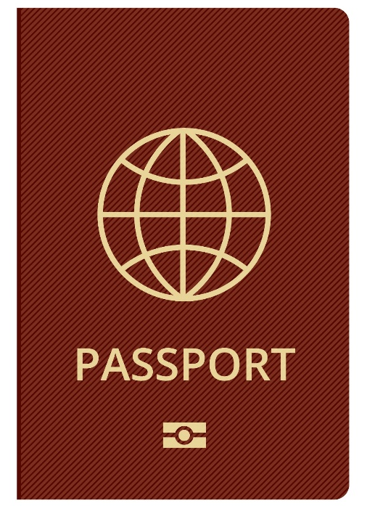
Tick the sentence which has correctly used a hyphen.
A. Daniel was a thorough-and hard working man.
B. There are some beautiful-looking flowers in the garden.
C. Philip suddenly remembered that he needed to re-new his passport.
Varied Fluency 2

Slide 27
Tick the sentence which has correctly used a hyphen.
A. Daniel was a thorough-and hard working man.
B. There are some beautiful-looking flowers in the garden. | ✓
C. Philip suddenly remembered that he needed to re-new his passport.
Varied Fluency 2

Slide 28
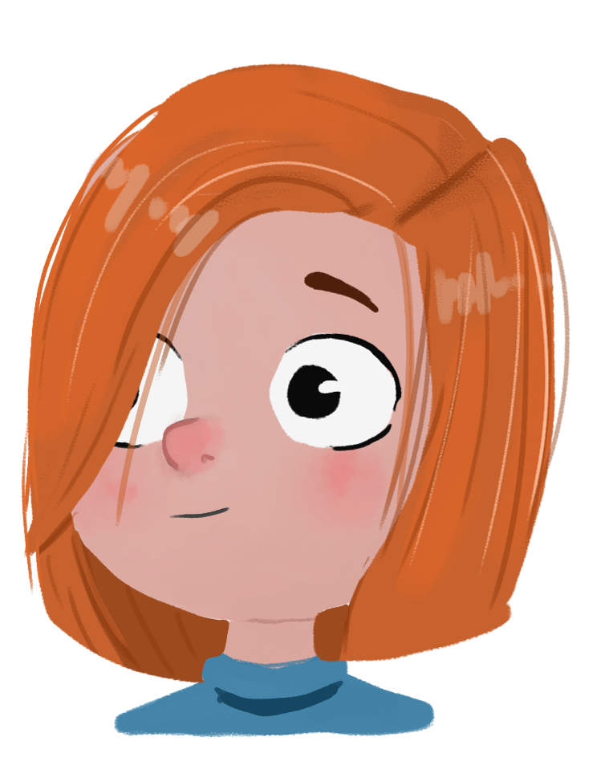
Tick the box to show where the hyphen should be added to the sentence below.
Min sadly remembered her fun loving friend, Sally.
Varied Fluency 3

Slide 29
Tick the box to show where the hyphen should be added to the sentence below.
✓
Min sadly remembered her fun-loving friend, Sally.
Varied Fluency 3

Slide 30
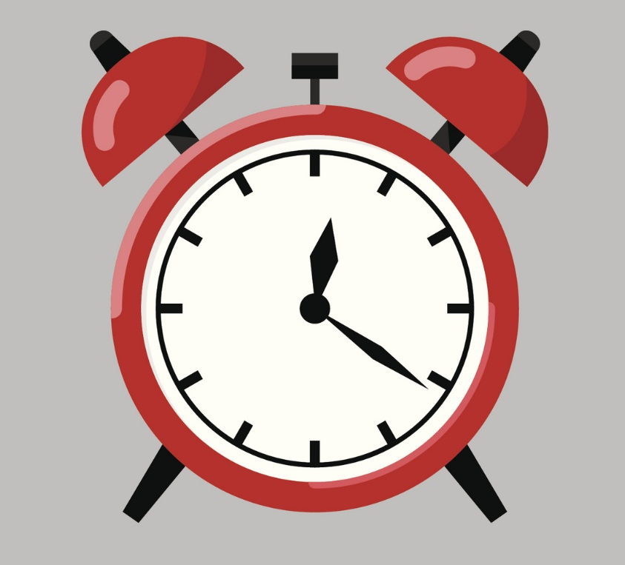
Choose the correct words from the word bank to complete the sentences below.
repaired | re-paired
The odd shoes were all eventually _________.
The broken clock was _________ at great expense.
Varied Fluency 4

Slide 31
Choose the correct words from the word bank to complete the sentences below.
repaired | re-paired
The odd shoes were all eventually re-paired.
The broken clock was repaired at great expense.
Varied Fluency 4

Slide 32
Which of the following uses a hyphen to avoid ambiguity? Explain your reasoning.
heat-loss |  | de-ice
sad-looking |  | close-up
brightly-lit |  | snow-white
Reasoning 1

Slide 33
Which of the following uses a hyphen to avoid ambiguity? Explain your reasoning.
heat-loss |  | de-ice
sad-looking |  | close-up
brightly-lit |  | snow-white
A close-up is a…. close up means…
Reasoning 1

Slide 34
Which of the following uses a hyphen to avoid ambiguity? Explain your reasoning.
heat-loss |  | de-ice
sad-looking |  | close-up
brightly-lit |  | snow-white
A close-up is a picture or film that shows a lot of detail whereas close up means to close completely, as in closing up a shop.
Reasoning 1

Slide 35
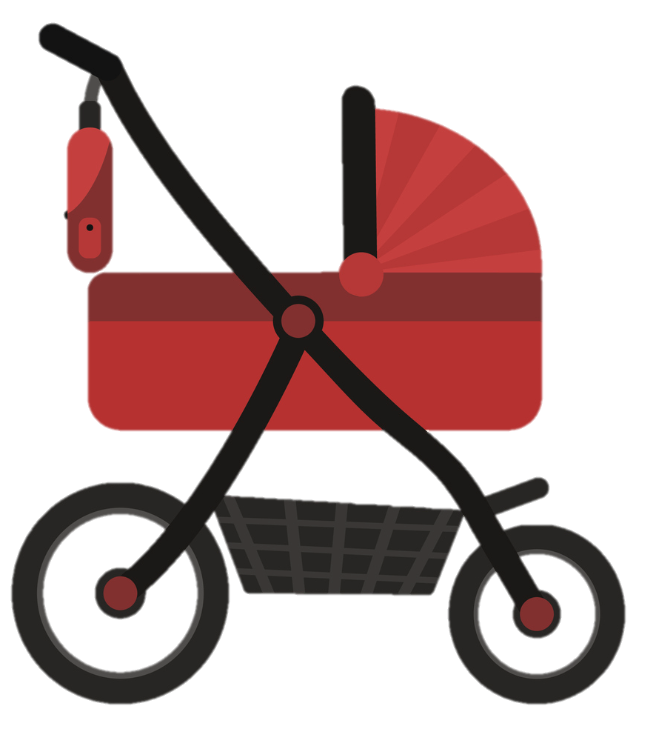
Rewrite the sentence below. Remember to put a hyphen in the correct place.
The quick thinking boy pulled the pram from the road just in time.
Application 1

Slide 36
Rewrite the sentence below. Remember to put a hyphen in the correct place.
The quick thinking boy pulled the pram from the road just in time.
The quick-thinking boy pulled the pram from the road just in time.
Application 1

Slide 37
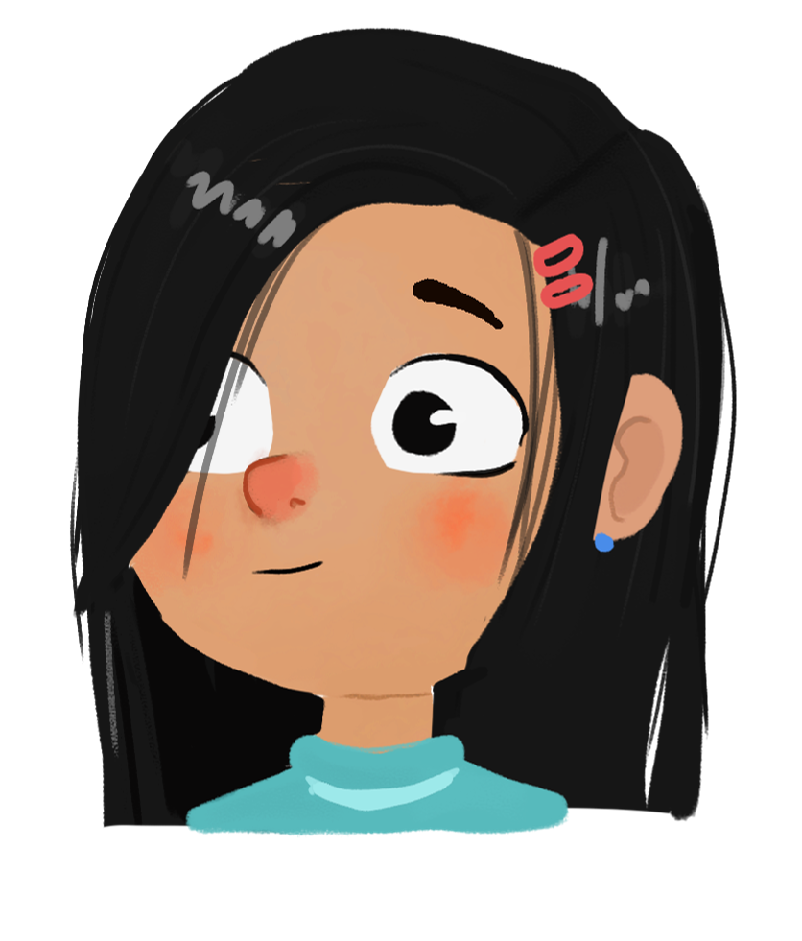
Helen has written the sentence below. Has she used a hyphen correctly?
 | Tara went to the library each
 | day with her book-loving
 | friends, Bet and Jennifer.
Reasoning 2

Slide 38
Helen has written the sentence below. Has she used a hyphen correctly?
 | Tara went to the library each
 | day with her book-loving
 | friends, Bet and Jennifer.
Yes, she has used a hyphen correctly because…
Reasoning 2

Slide 39
Helen has written the sentence below. Has she used a hyphen correctly?
 | Tara went to the library each
 | day with her book-loving
 | friends, Bet and Jennifer.
Yes, she has used a hyphen correctly because she is describing Tara’s friends that love books; without a hyphen the sentence describes Tara’s loving friends.
Reasoning 2

