Slide 1
Disclaimer/s
We hope you find the information on our website and resources useful.
Displaying the Presentation
To ensure this presentation displays correctly: If you are a Mac user, the presentation may open in 'slide master' mode - to see all the content, click 'close slide master' and the presentation should display correctly. If you are using Google Drive, the presentation won't display correctly if you open it in Google Slides. If you have opened it in Google Slides,
you will need to download it again from the Twinkl website and this time open it from
your computer.
Animations
This resource has been designed with animations to make it as fun and engaging as possible. To view the content in the correct formatting, please view the PowerPoint in ‘slide show mode’. This takes you from desktop to presentation mode. If you view the slides out of ‘slide show mode’, you may find that some of the text and images overlap each other and/or are difficult to read.
To enter slide show mode, go to the slide show menu tab and select either from beginning or from current slide.
You may wish to delete this slide before beginning the presentation.

Slide 2
Maths
Measurement
Maths | Time | Sequencing Events in Chronological Order | Lesson 2 of 2: Sequence Daily Events

Slide 3
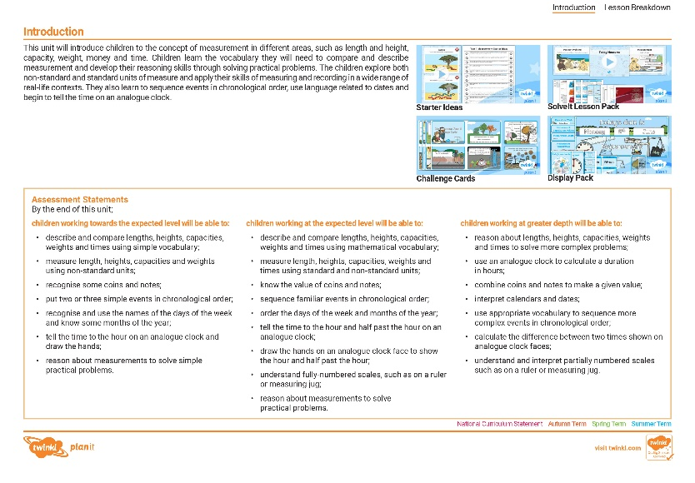
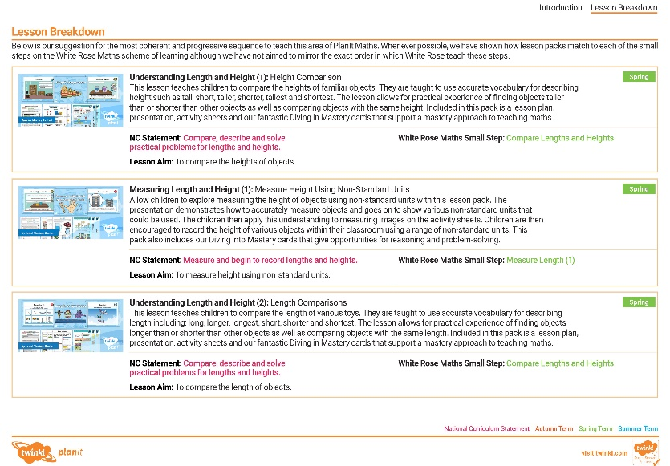
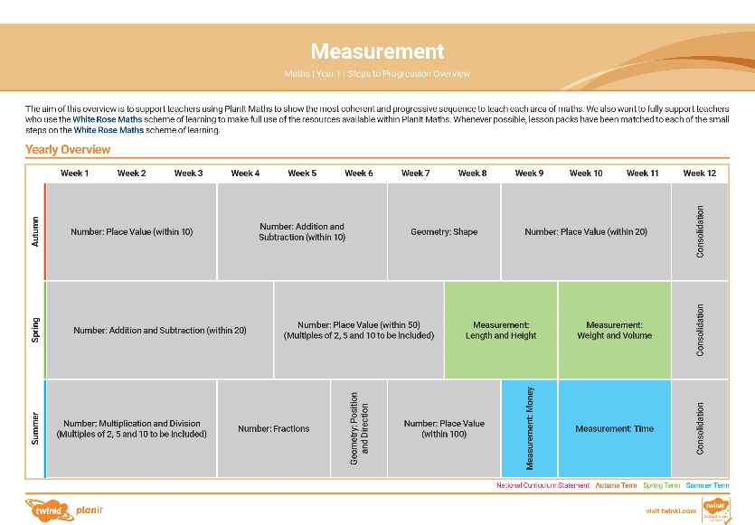

Need a coherently planned sequence of lessons to complement this resource?
See our Measurement Steps to Progression document.
Twinkl PlanIt is our award-winning scheme of work with
over 4000 resources.

Slide 5
Aim
To sequence and describe the order of daily events.
Success Criteria
I can match events with times of the day.
I can sequence pictures to show the order of daily events.
I can use sequencing words to describe the order of daily events.
I can complete challenges relating to the sequence of daily events.

Slide 6


Remember It
This lunch box is empty.
What could have happened before this picture?
Is there more than one possibility?
Here are some ideas
The box is empty because the food has been eaten.
The box is empty because it hasn’t been packed yet.

Slide 7
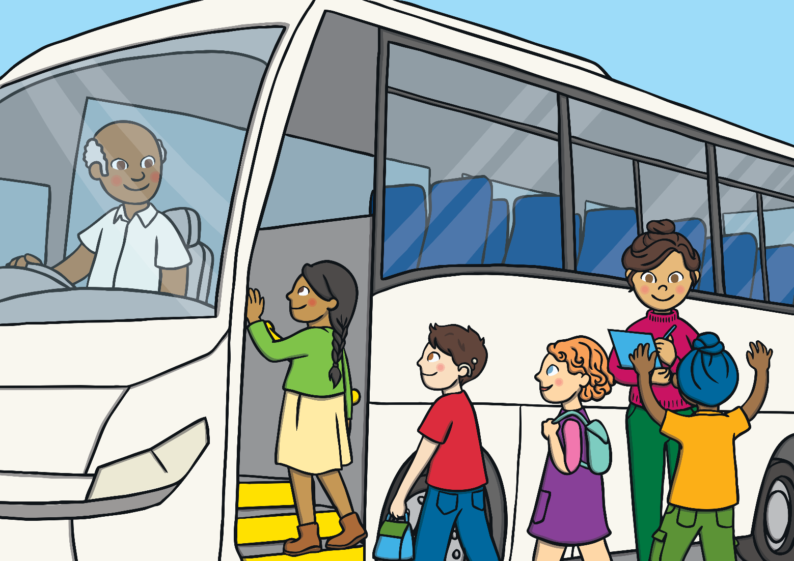
Remember It
What could have happened after this picture?
Share your ideas with a learning partner.

Slide 8





Parts of the Day
What do we call the first part of the day?
What do you know about the night?
What is the next part of the day called?
What do you know about the afternoon?
What do we call this part of the day?
A day can be split into 4 parts.
What is the last part of the day called?
What can you tell me about the morning?
What can you tell me about the evening?
Day
morning
afternoon
evening
night

Slide 9
Parts of the Day
Which part of the day is this?
Later than the evening.
Earlier than the afternoon.
morning
afternoon
evening
night
earliest
latest

Slide 10
Parts of the Day
Which part of the day is this?
Earlier than the evening.
Is there more than 1 possible answer?
morning
afternoon
evening
night
earliest
latest
Let’s add an extra clue…
Earlier than the evening and later than the morning.

Slide 11
Parts of the Day
Take turns with a partner to give clues describing part of the day.
Use these words to help you:
earlier
later
morning
afternoon
evening
night
earliest
latest

Slide 12
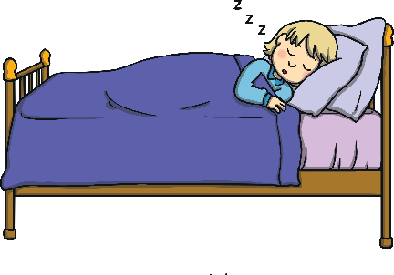
When?
Match the activities with the different times of day.
When do you go to sleep?
Why do you think we sleep during this part of the day?
morning
afternoon
evening
night

Slide 13
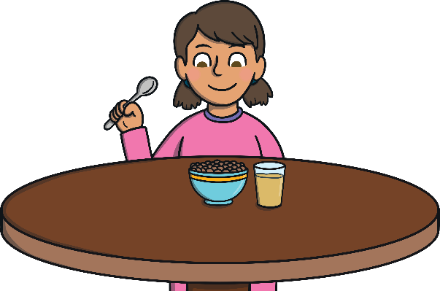
When?
Can you think of more activities that you do in the morning?
When do you eat your breakfast?
Why is this important?
Breakfast gives us energy for the day ahead.
morning
afternoon
evening
night

Slide 14
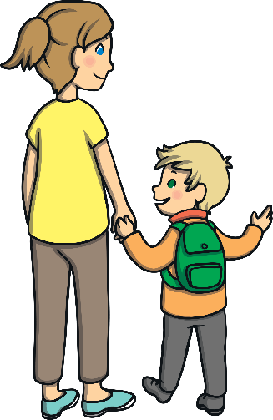
When?
When do you go home from school?
Can you think of more activities that you do in the afternoon?
morning
afternoon
evening
night

Slide 15

When?
When do you relax?
Can you think of more activities that you do in the evening?
morning
afternoon
evening
night

Slide 16
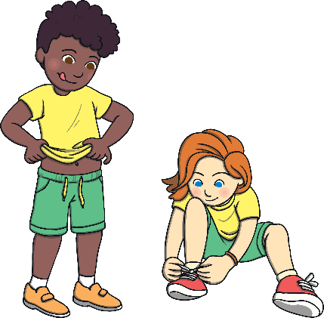
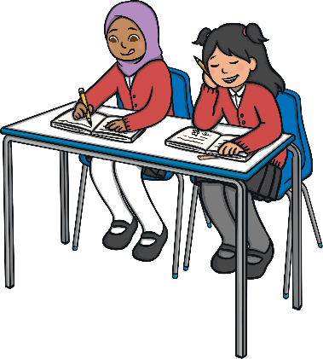
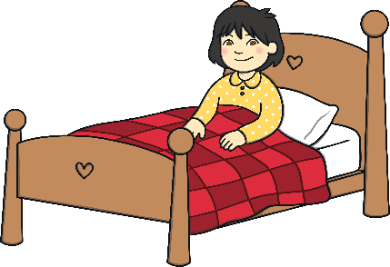

Sequencing Challenge
Sequence these morning activities.
Choose words to help you explain when they happen.
before
after
earlier
later
get dressed
wake up
school
There are lots of ways to explain this. Here is one idea.
I get dressed after I wake up and before I go to school.

Slide 17

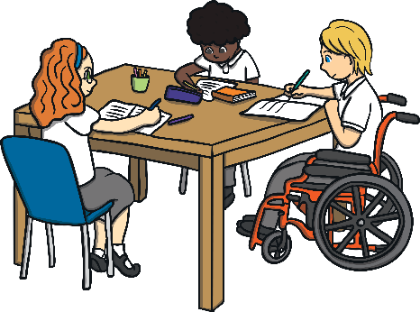


Sequencing Challenge
Sequence these morning activities.
Choose words to help you explain when they happen.
before
after
earlier
later
lunch
home time
lesson
There are lots of ways to explain this. Here is one idea.
Lunch time is earlier than my lesson. Home time is later.

Slide 18

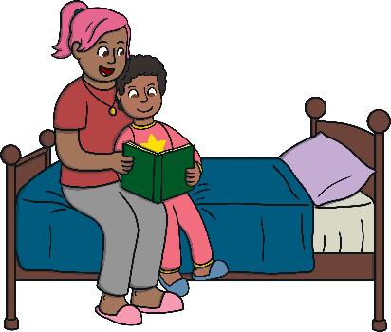
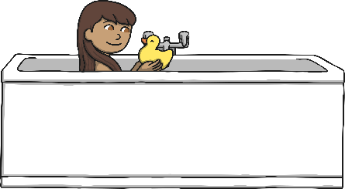

Sequencing Challenge
What do you notice about this sequence of activities?
What would happen if we did them in this order?
How would you sequence them?
Can you explain why?
sleep
bath
bedtime story
There are lots of ways to explain this. Here is one idea.
I have a bath before my bedtime story.
I go to sleep after my bedtime story.

Slide 19

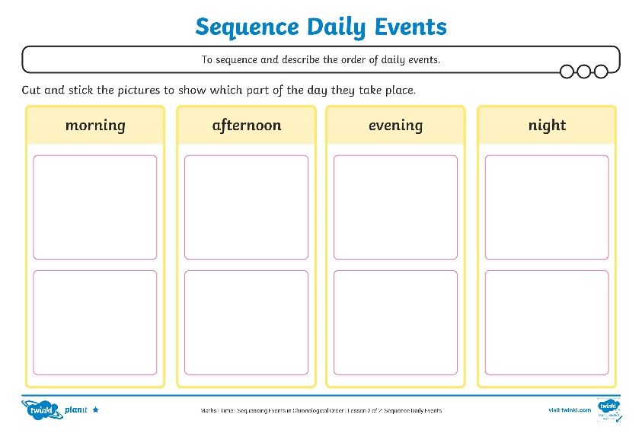
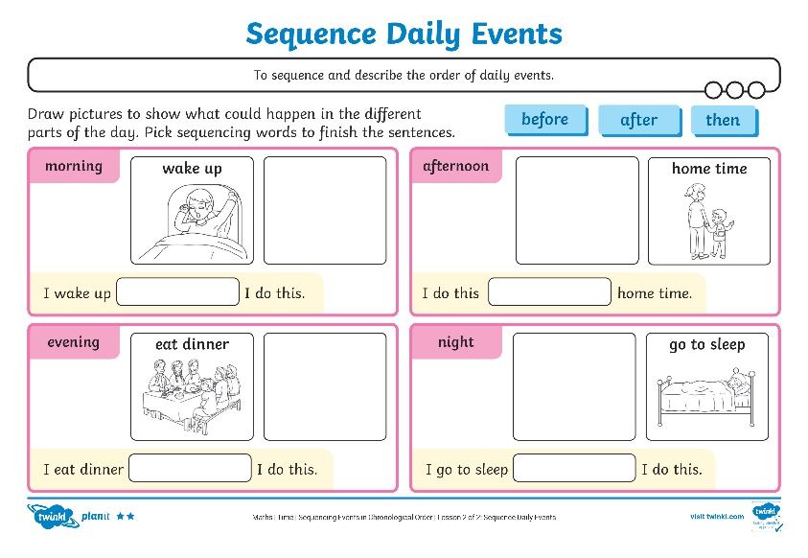
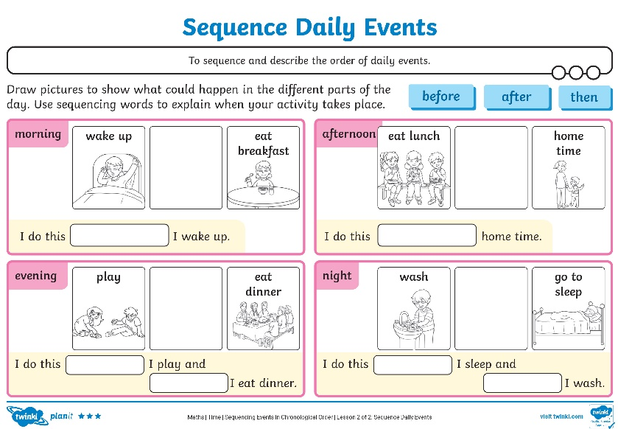
Sequence Activities

Slide 20
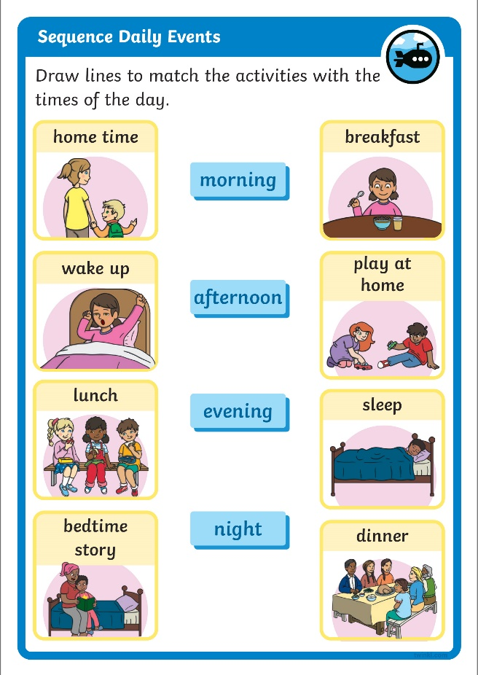
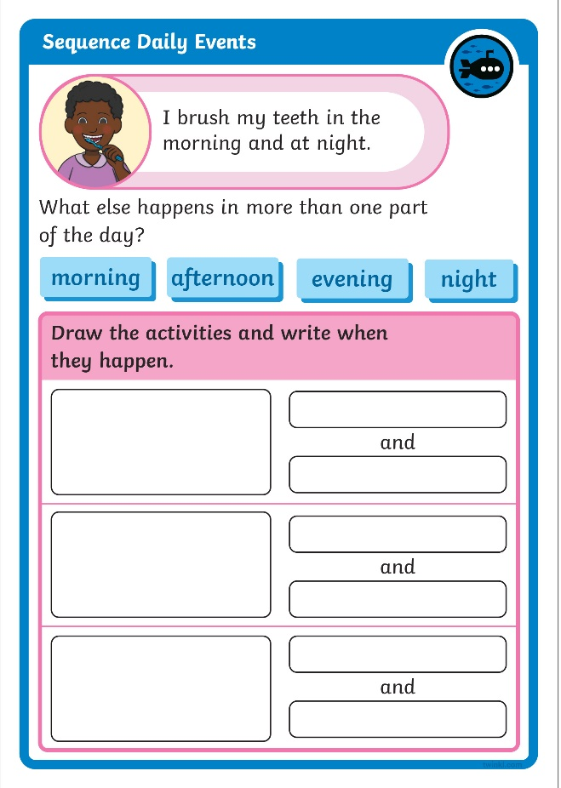

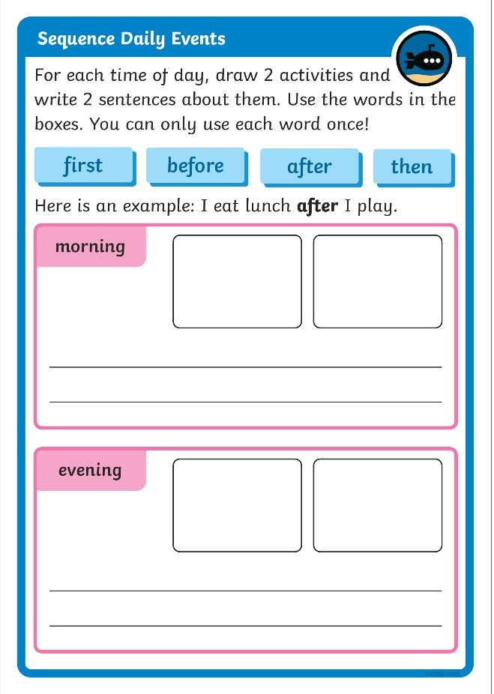
Diving into Mastery
Dive in by completing your own activity!

Slide 21



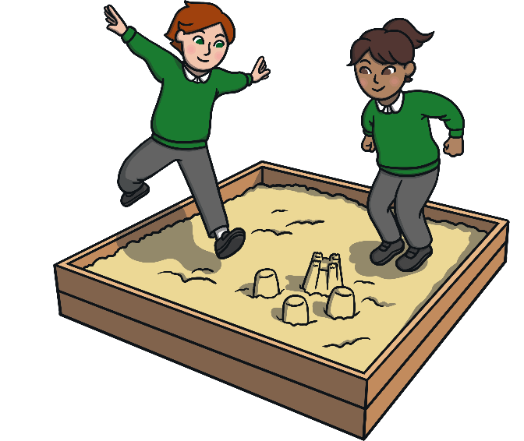
True or False?
Thumbs up for true.
Thumbs down for false.
Playtime is later than breakfast.

Slide 22
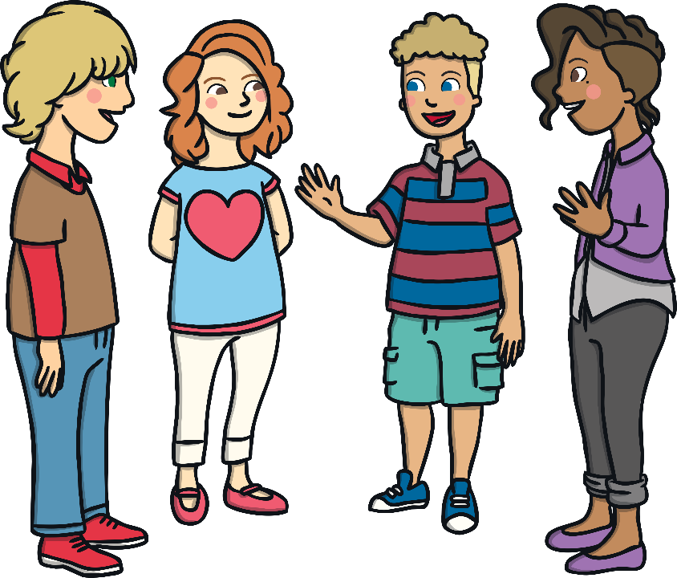
True or False?
Take turns with a learning partner to make your own true or false challenge. Use these words to help you.
before
after
earlier
later

Slide 23
Aim
To sequence and describe the order of daily events.
Success Criteria
I can match events with times of the day.
I can sequence pictures to show the order of daily events.
I can use sequencing words to describe the order of daily events.
I can complete challenges relating to the sequence of daily events.

